Slide 1
A REPORT ON A FMCG RETAIL BUSINESS FROM 2024-2026
BY ASAKOME OGHENAKHOGIE CELESTINE
DATA ANALYST

Slide 2
Brief overview
The dataset contains approximately 1800 transaction records.
  Each row represents a customer purchase transaction.
  The dataset includes 12 columns covering customer information, product category, price, quantity, and payment method.
  The dataset simulates real-world retail transaction data.

Slide 3
Project Objectives
The main goals of this analysis are:
  Clean and standardize the dataset
  Handle missing and invalid values appropriately
  Create new analytical features such as revenue
  Analyze sales trends and product category performance
  Generate insights to support business decision-making

Slide 4
Data Quality Issues Identified
Several common data quality problems existed in the dataset:
  Missing values in age, email, unit_price, quantity, and transaction_date
  Inconsistent country naming (e.g., Nigeria vs nigeria, USA vs United States)
  Mixed data types in the unit_price column
  Negative or invalid quantity values
  Case inconsistencies in product_category and payment_method

Slide 5
DATA CLEANING METHODS
All inconsistent namings were corrected and adjusted to a single standard.
Mixed data types in unit_price column were converted into numbers.
Negative or invalid quantity values were adjusted.
Missing values in age and unit _price were handled by using averages while data with missing transaction dates were removed entirely.
Missing emails were left unattended to.

Slide 6
Exploratory Data Analysis
After cleaning the dataset, exploratory analysis focuses on:
  Sales distribution across countries
  Most popular product categories
  Customer age distribution
  Sales trends over time

Slide 7
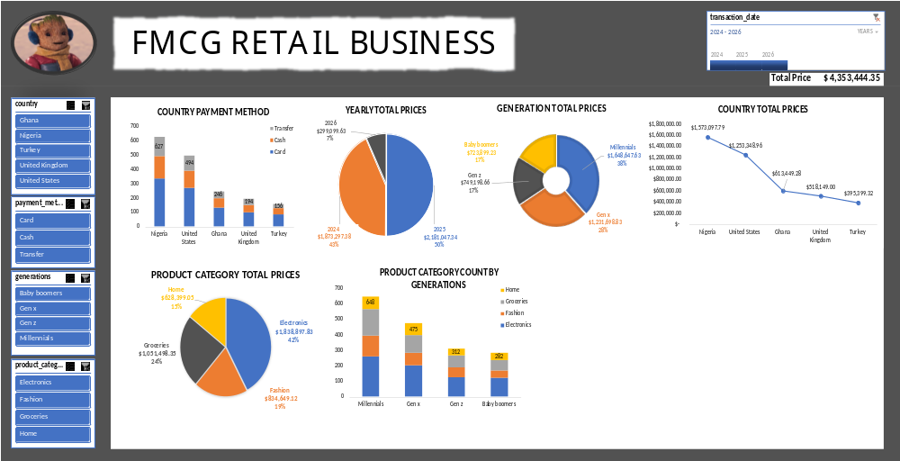

Slide 8
KEY INSIGHTS AND RECOMMENDATIONS
INSIGHTS
RECOMMENDATIONS
Nigeria and United States generated the most revenue while Turkey and United Kingdom generated the least revenue
Electronics were the most sold product category.
Millennials represent the core customer base.
Revenue increased yearly.
Most customers prefer using card as a means for payments.
Expand the market in Nigeria and United States to maximize profits and investigated why the low revenues in Turkey and United Kingdom.
Increase inventory for electronics and promote less sold product categories more.
Target the millennials base and develop strategies to increase other generations engagements.
Continue using working strategies.
Increase card payment systems.

